Slide 1

Movie Recommendation System
ABES Engineering College, Ghaziabad, UP
Department of CSE-DS
Mini-Project Presentation-1
Project Domain: MERN
Project Group No: CSDS2-G05
Project guide: DR. AMIT KUMAR PANDEY
Team members: Bharat singhal,2200321540055
Chirag Gupta ,2200321540057
Deepak yadav, 2200321540061
Devansh vashisHtha,2200321540067

Slide 2
Contents
Abstract
Introduction
Objectives
Requirements of Project
Methodology
Expected Outcome
References

Slide 3

Abstract
Movie recommender systems are meant to give suggestions to the users based on the features they love the most.
A highly performing movie recommendation will suggest movies that match the similarities with the highest degree of performance.
It highlights the filtering criteria in the recommender systems and algorithms that are implemented in movie recommender systems.

Slide 4
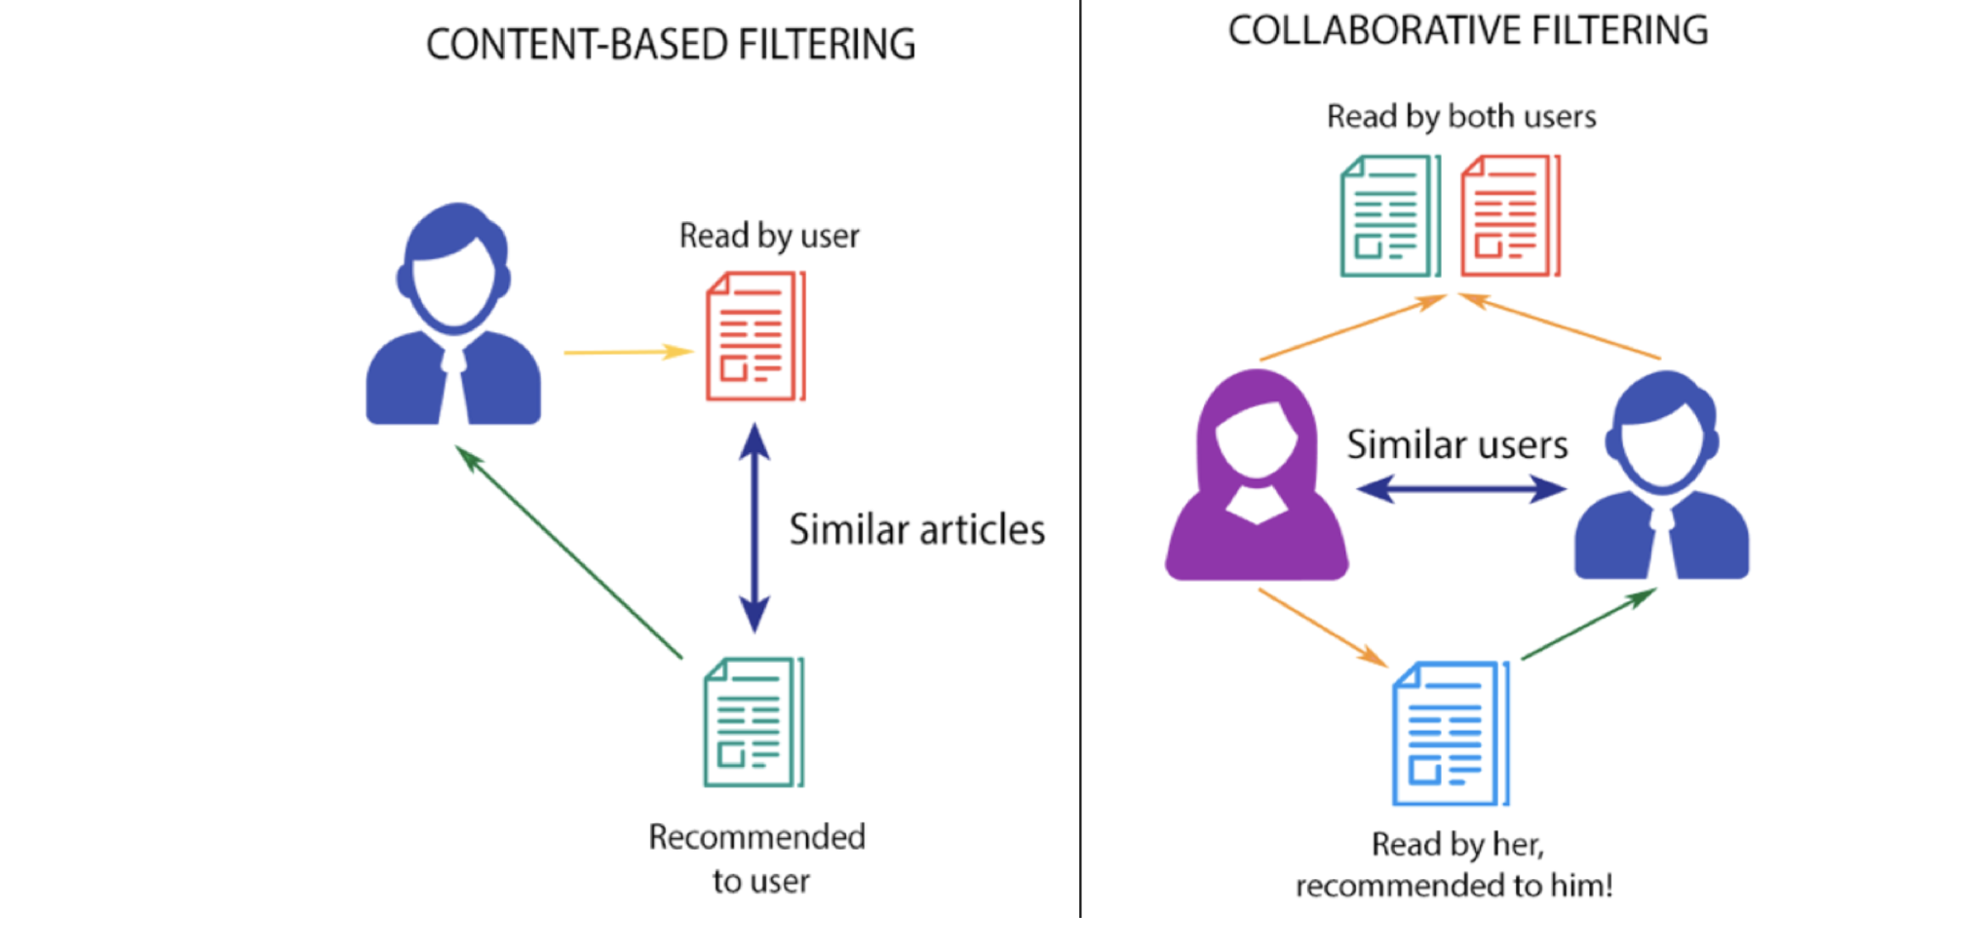
Introduction
A movie recommendation system, or a movie recommender system, is an ML-Based Approach to filtering or predicting the users’ film preferences based on their past choices and behavior.
The ML algorithms for these recommendation systems use the data about this user from the system’s database. This data is used to predict the future behavior of the user concerned based on the information from the past.
The most popular categories of the ML algorithms used for movie recommendations include content-based filtering and collaborative filtering systems.

Slide 5
Objectives
The goal of our movie recommendation system is to develop a movie recommendation system for binge watchers to help and recommend them good qualities of movies
The Main Objectives are:
Improving the accuracy of recommendation systems
Improve the quality of movie recommendation systems
Enhancing the user experience
Explore different Technologies as a group

Slide 6
Existing Work of Project
Pre-Processing of Dataset from its loading to its selection and filtering.
Frontend Webpage
Main Recommender System
About Us
Login Page
Contact Us
Backend Machine Learning Model training using Python
Usage of MySQL in Data Retrieval.

Slide 7
Requirements of Project
FRONTEND
HTML, CSS
BACKEND
Python
DEPLOYMENT
Streamlit
DATASET
CSV Files for Dataset

Slide 8
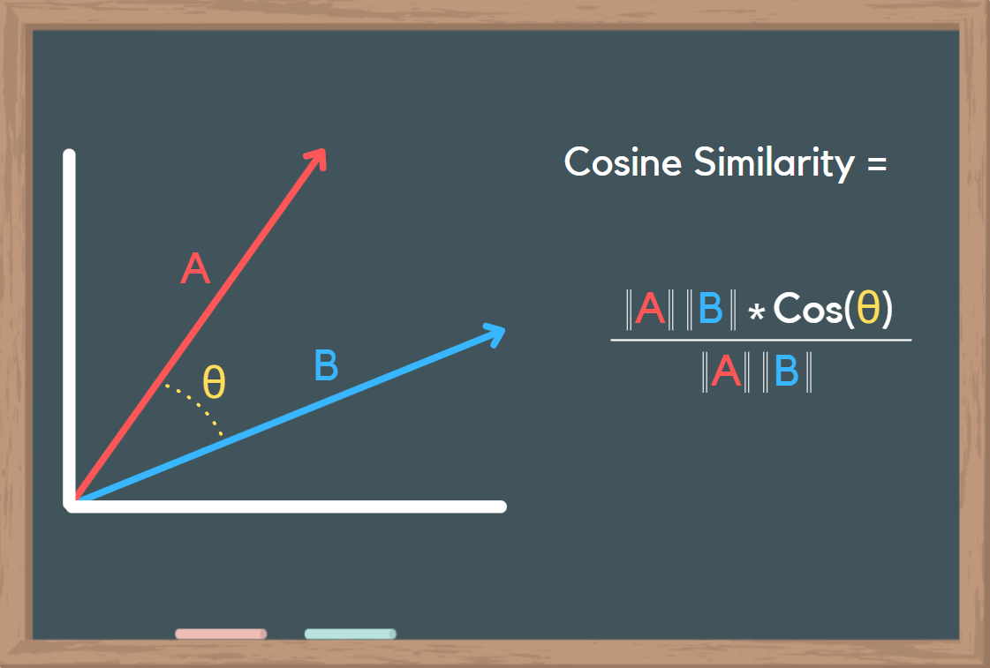
Methodology
Cosine similarity is used as a metric determining the distance between the neighbors in our recommendation systems.
Cosine similarity is used to recommend movies with the same similarities and for text entered by the user.
Cosine similarity in the recommendation system is used with the same principle of cosine angles

Slide 9
Methodology
Sentiment Analysis is a technique that comes under natural language processing(NLP) and is used to predict the emotions reflected by a word or a group of words
We have used Naive Bayes Algorithm for Sentiment Analysis in our Recommendation System to process the Movies based on the Similar Sentiment Labels from the Database.
We have referenced our data from the Database.

Slide 10
Expected Outcomes
User Satisfaction: The primary goal is to provide users with movie recommendations that align with their preferences, leading to higher satisfaction and engagement.
Time Efficiency: Users spend less time searching for movies, as the system efficiently narrows down options based on their preferences.
Retention: By consistently delivering relevant suggestions, the system contributes to user retention, ensuring that users continue to use the platform over time.

Slide 11
Thank You !

